Slide 1
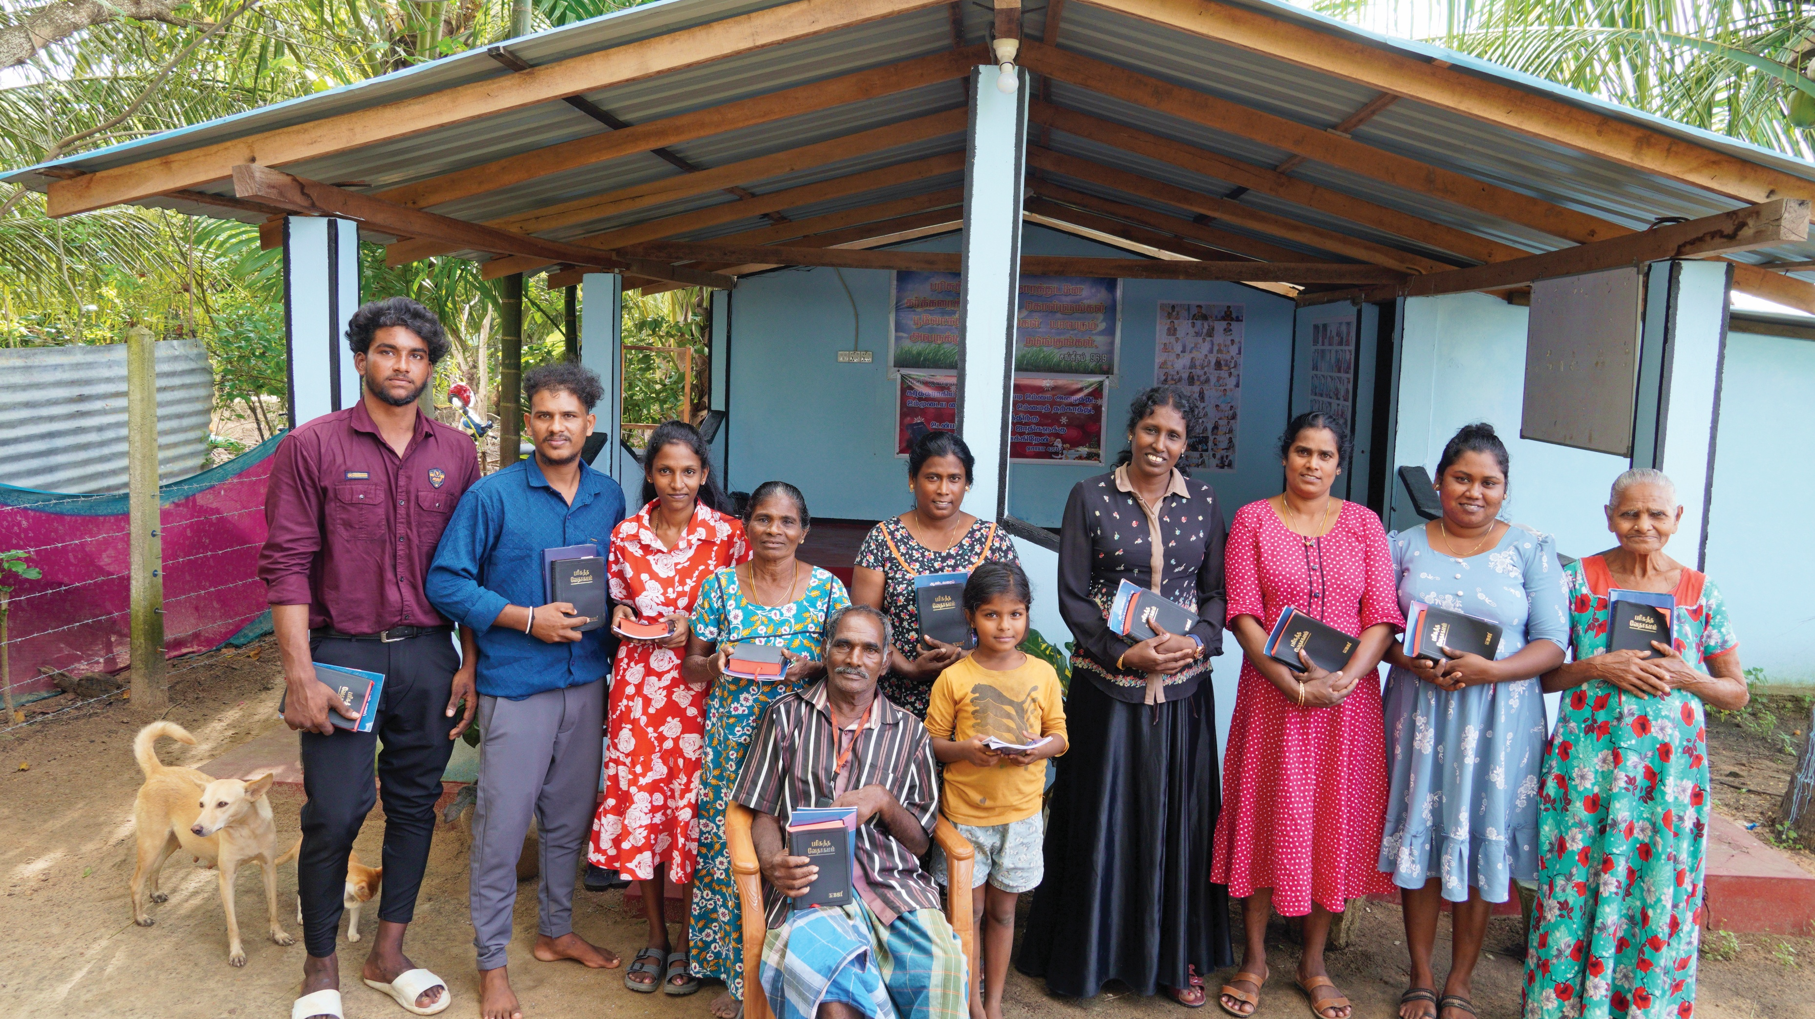

One Mission
One Heart

Slide 2
We’re Not All That Different
Like you, our priority is to help people meet and develop a
dynamic relationship with Jesus Christ through
biblical engagement—so that they become actively involved
in faith-affirming Christian communities.
You do this as a localized expression of the global Church.
We pursue it as a Christian organization serving and
equipping the global Church.
We share the same calling and mission.
And we both long to see lives transformed through God’s Word.

Slide 3
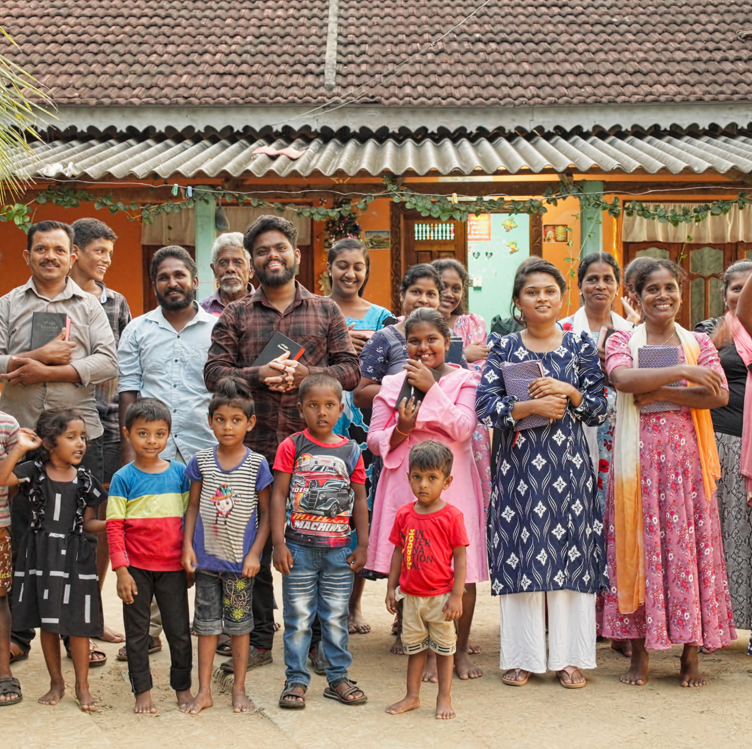
What we know
about you
You long to see
even more people
coming to Christ
than you already have.

Slide 4
So he came to them and said,
“All authority in heaven and on earth is given to me. So go and make followers of all people in the world. Baptize them in the name of the Father and the Son and the Holy Spirit. Teach them to obey everything that I have told you to do. You can be sure that I will be with you always. I will continue with you until the end of time.”
Matthew 28:18-20 ERV

Slide 5
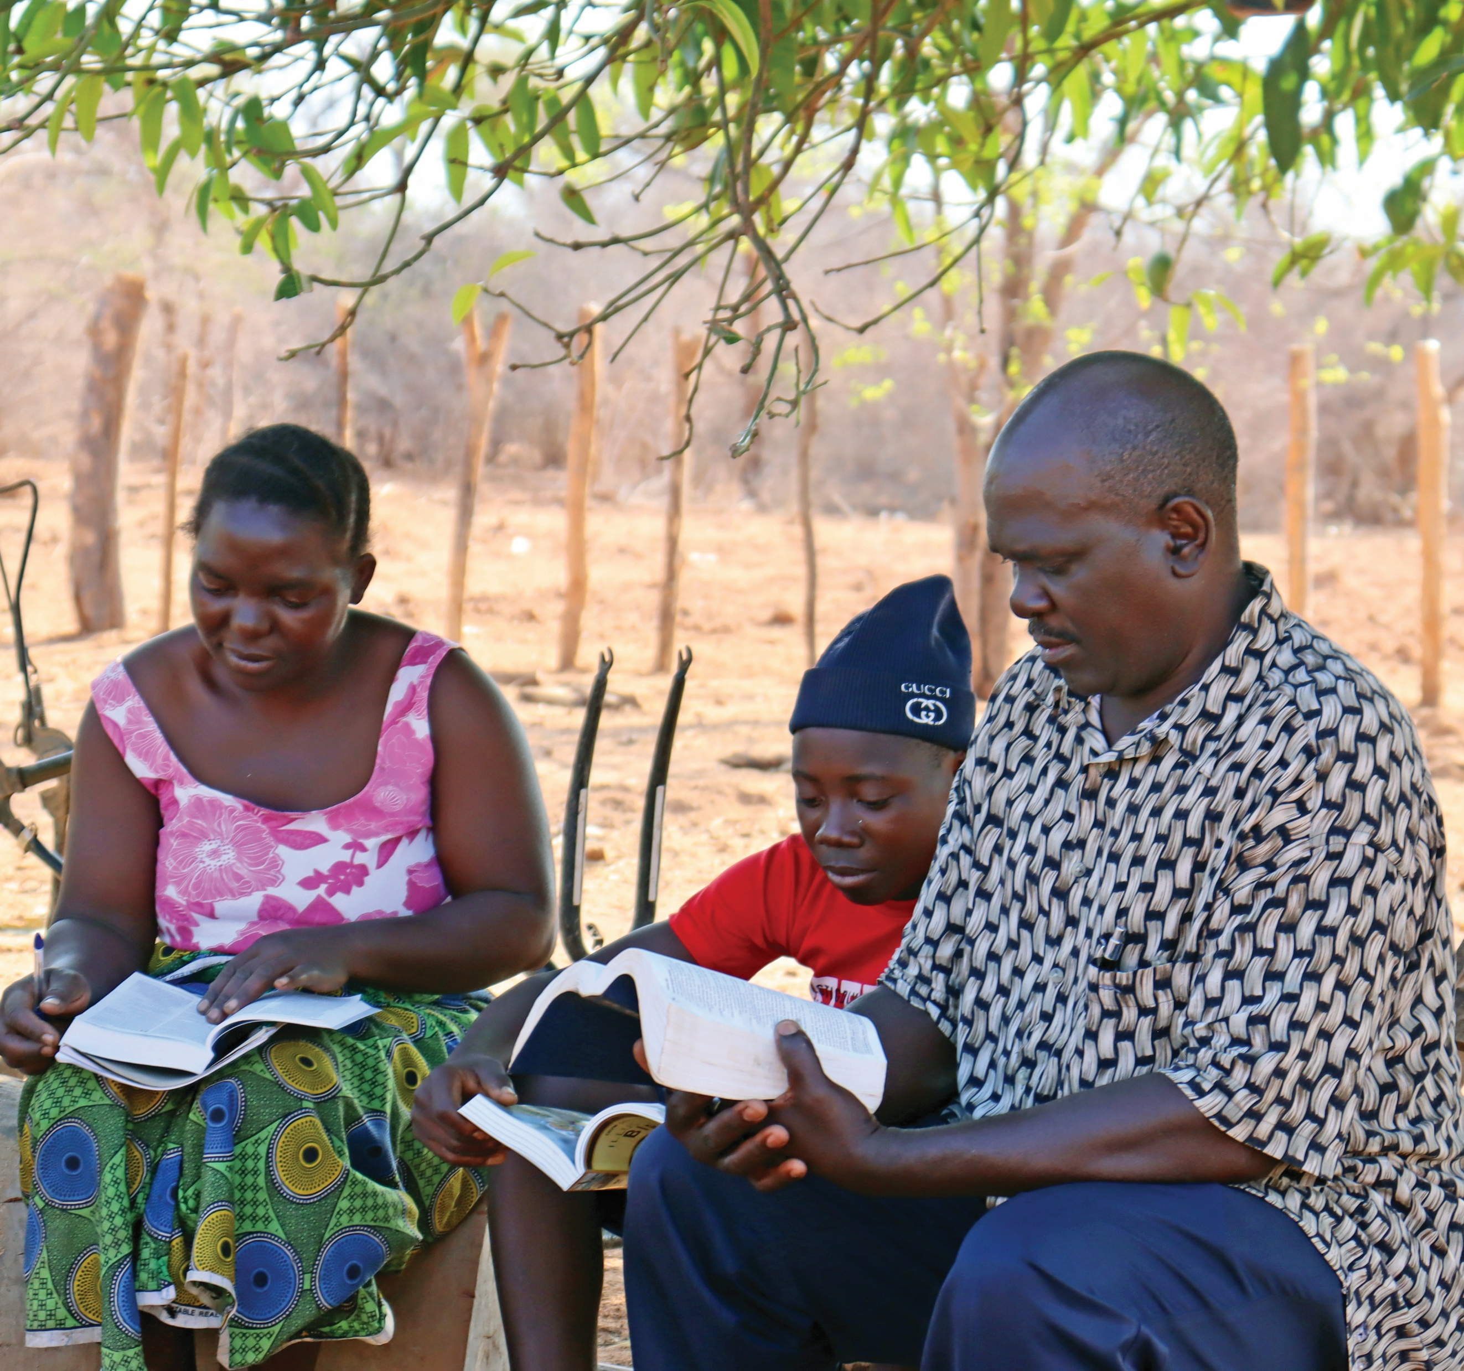
What we know
about you
Jesus’ call to
“go make disciples”
inspires and drives
all that you do.

Slide 6
But the Holy Spirit will come on you
and give you power. You will be
my witnesses. You will tell people
everywhere about me—in Jerusalem,
in the rest of Judea, in Samaria, and
in every part of the world.”
Acts 1:8 ERV

Slide 7
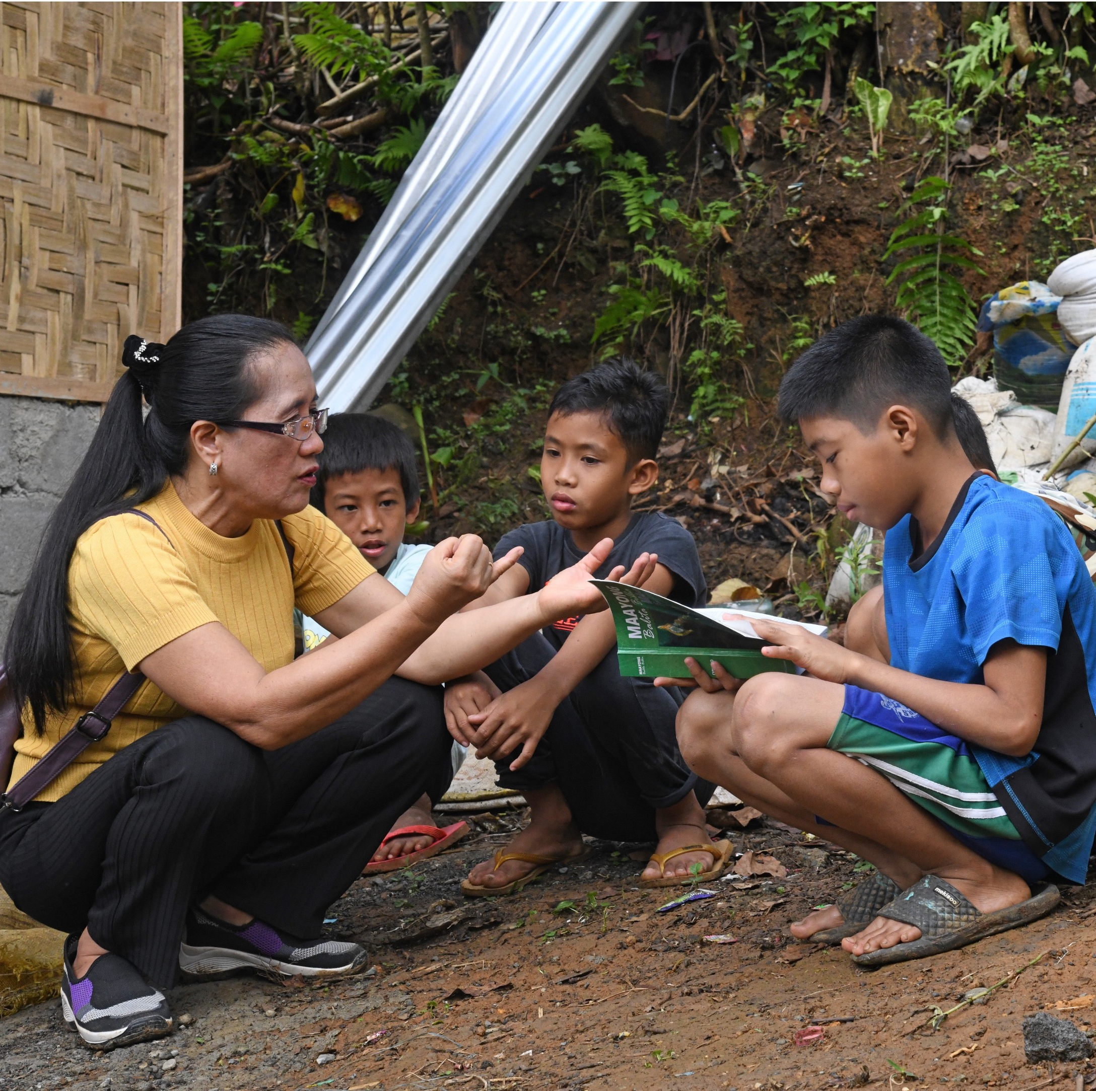
What we know
about you
You continue to ask
how you might
expand your reach to
the “ends of the earth.”

Slide 8
Us too.

Slide 9
About us
Founded by prayer in 1938,
Bible League has been offering
the hope of God’s Word
around the globe for over 87 years.
Today, we continue sharing Bibles,
along with study tools and training,
to reach those in need of salvation.

Slide 10
Our Mission
Serving the under-resourced Church with Bibles and training
to transform lives worldwide through God’s Word

Slide 11
Our Vision
We desire to see thriving local churches around the world
offering salvation, life change, and hope through
biblically-based training and resources that meet the
spiritual, moral, and social needs of their communities.

Slide 12
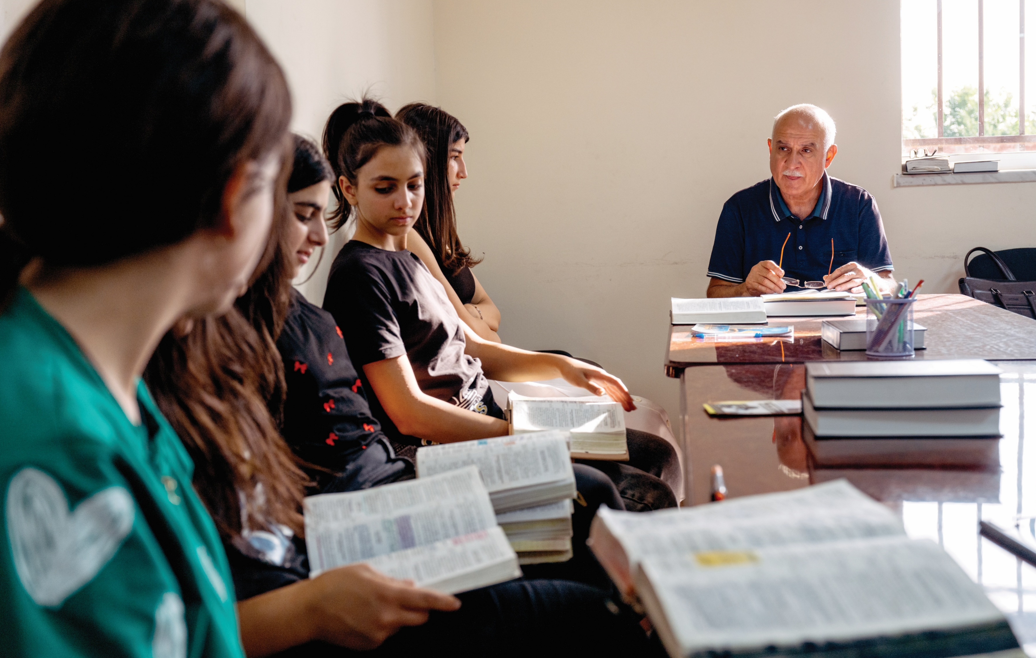
Quick Facts
400,000+
People reached annually
with the Gospel,
using Bible League’s
Church Planter Training

Slide 13
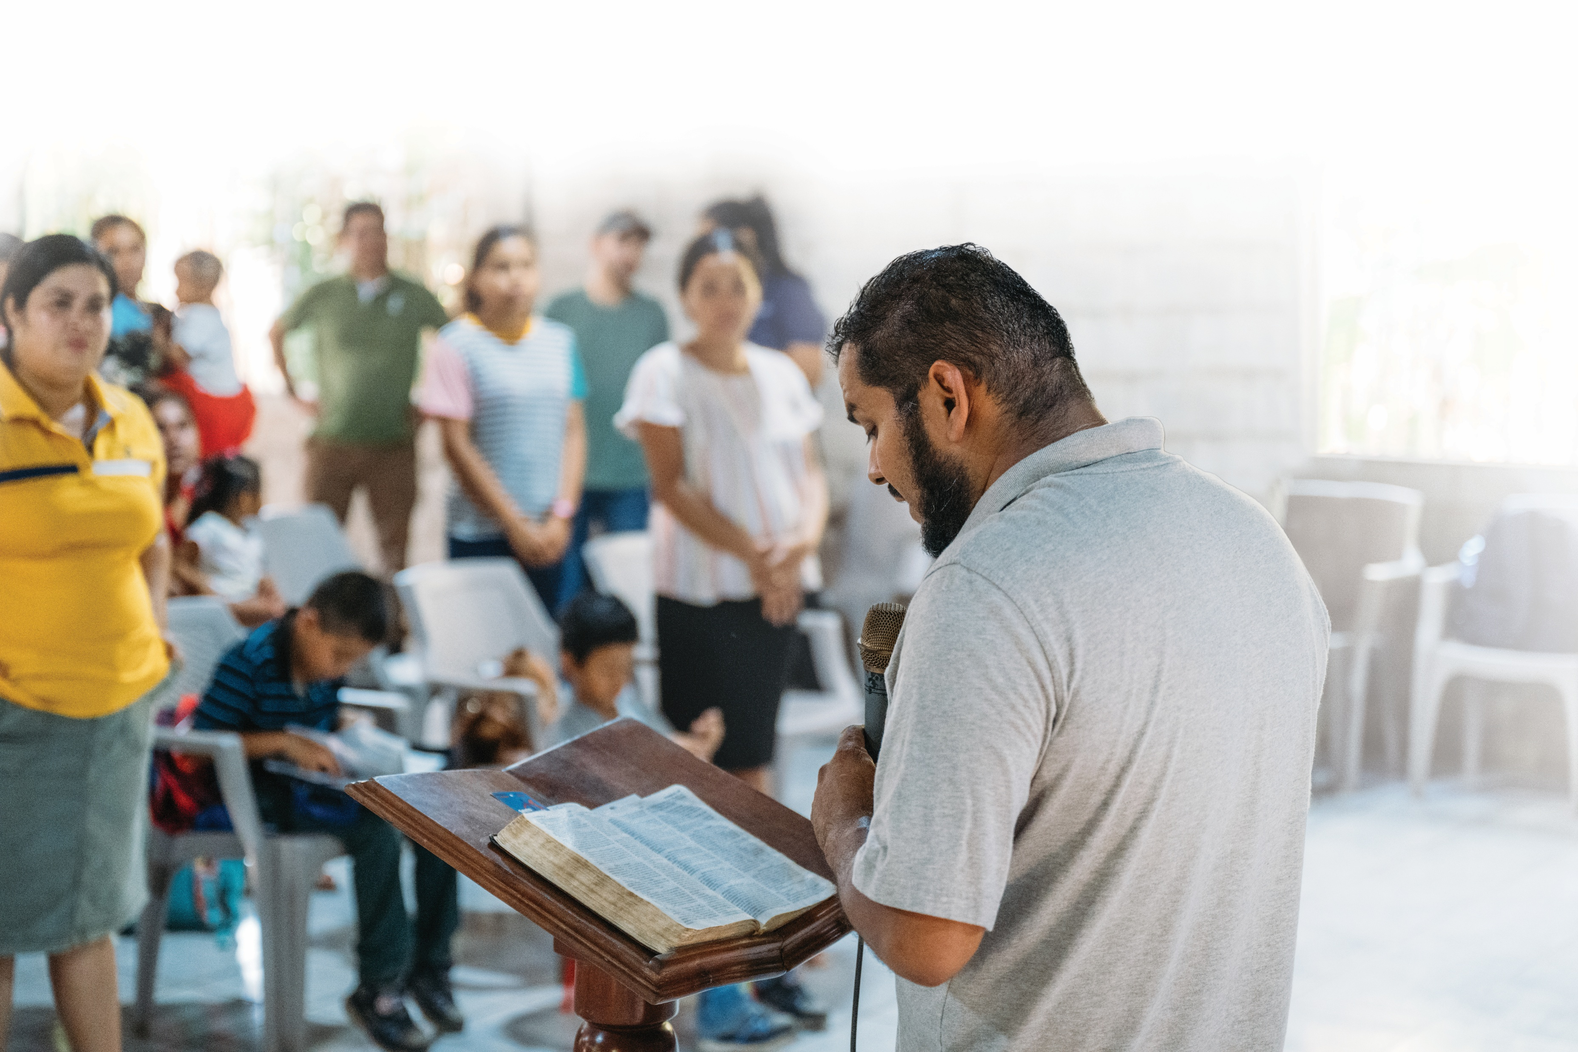
Quick Facts
82,000
The number of new churches Bible League’s
Church Planter Training helped launch since 1989
= one new church every 6 minutes

Slide 14
How might we partner to see God move?

Slide 15
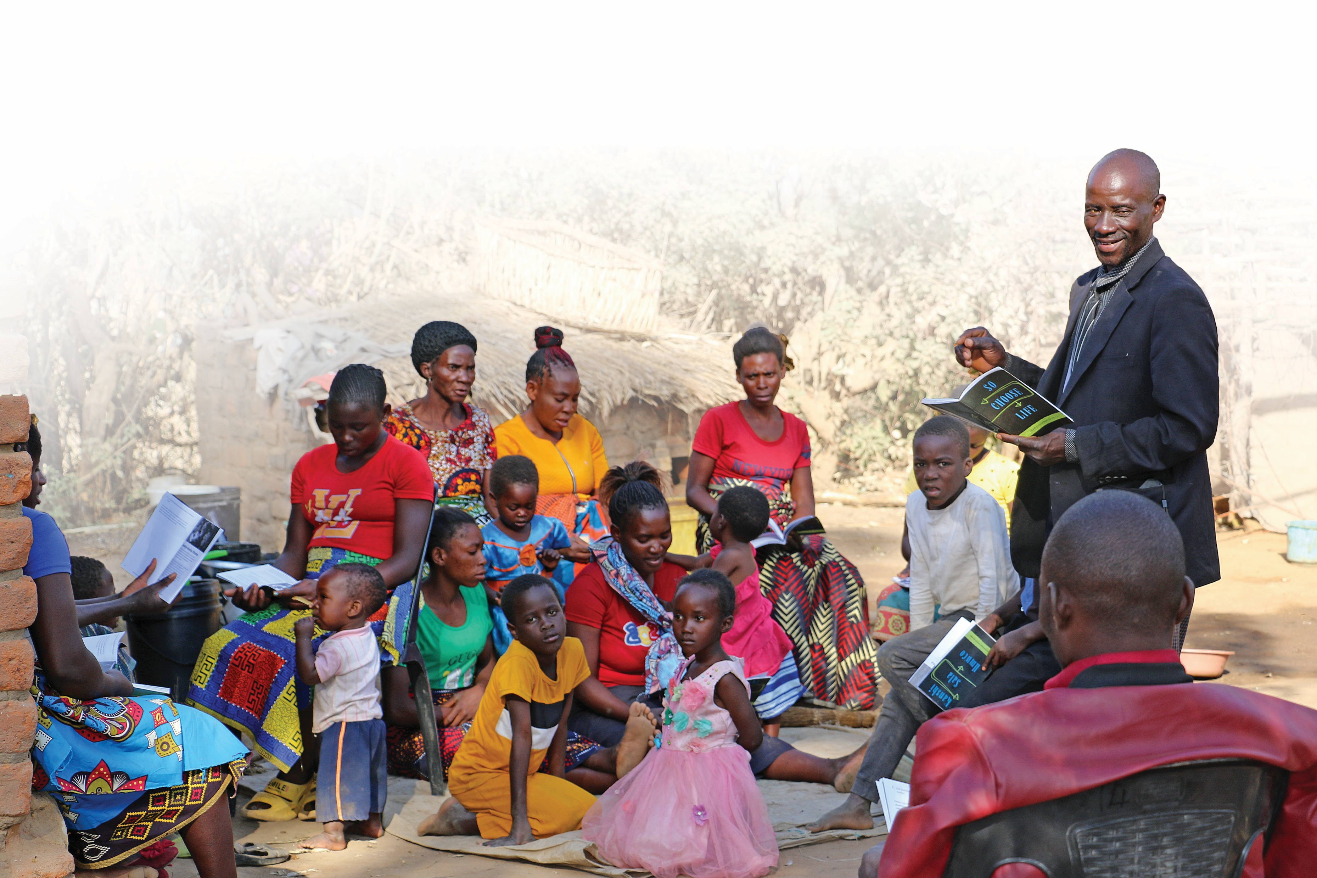
Partnering with Bible League
Join a growing movement
of church planters by helping
to provide:
Bibles
Bible study booklets
Training

Slide 16
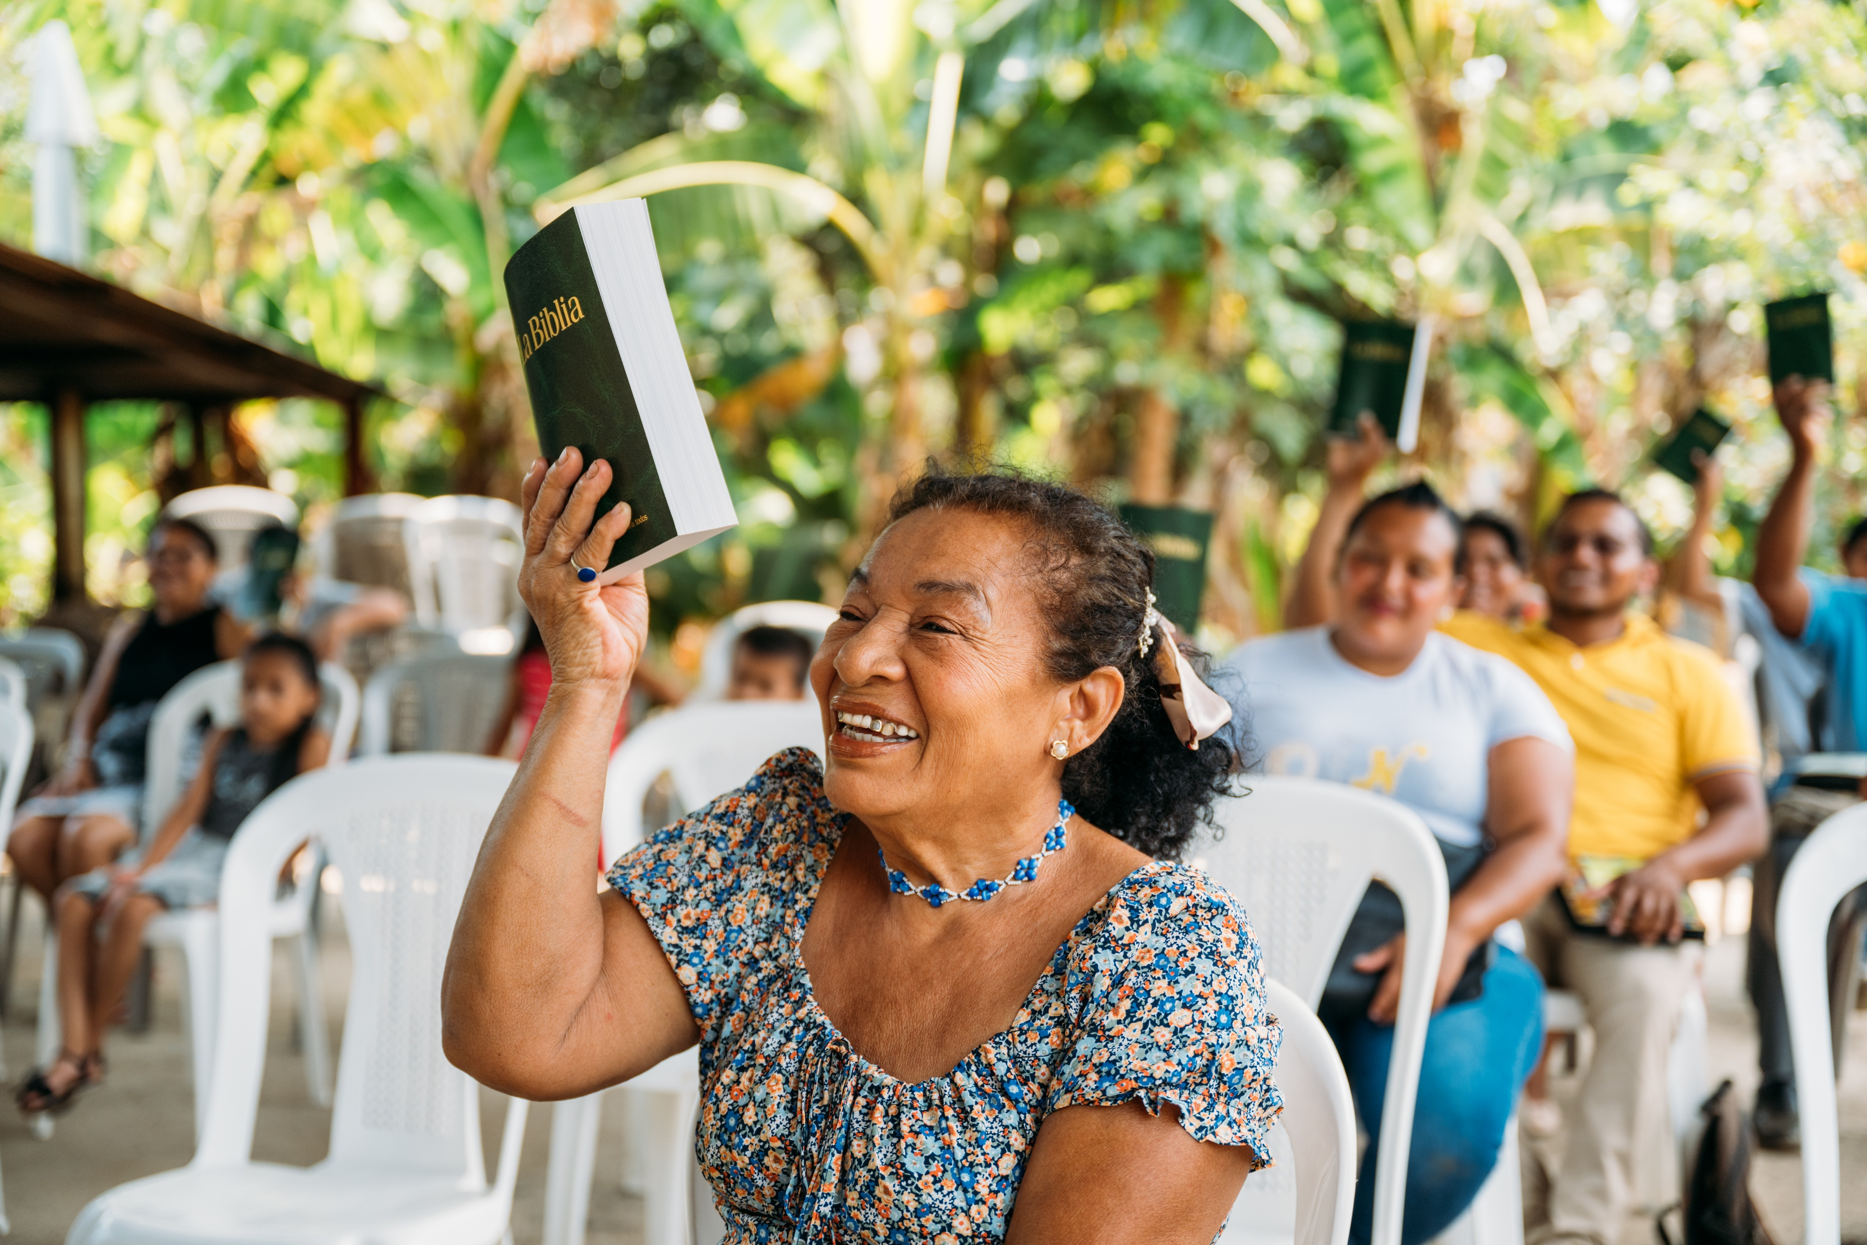

Your potential impact
$1,500 provides one
church planter with:
One year of training
85 Bibles
370 Bible study booklets
= enough to launch a new church in a
difficult-to-reach part of the world

Slide 17
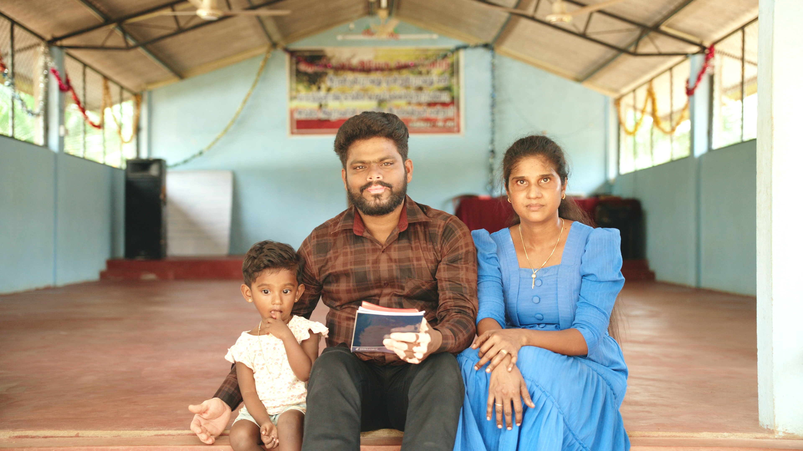
A Firsthand Account
(Video)
Ameer, a former Hindu, is planting churches and
bringing God’s Word to northern Sri Lanka.

Slide 18

Next Steps
Pray about your involvement
Determine how many church planters your church will help support
Join the movement by visiting bibleleague.org/engagemychurch
Questions? Email engagemychurch@bibleleague.org

Slide 19
Thank you
from all of us at Bible League International.

